Slide 1
SQL Programming
DDL Summary

Slide 2
Module 07: DDL Summary Page A-1: Intro
We’ve pretty much covered the data definition language (DDL) statements, and this would be a good time for a quick review.

Slide 3
Module 07: DDL Summary Page B-1: CREATE
Database objects are created in the database with the CREATE command.
The general form of the CREATE statement is:
CREATE object_type, object_name
[additional details]
Where object_type specifies the kind of object we want to create (TABLE, VIEW, …),
and object_name specifies the name we choose to assign to this object.
For example:
CREATE TABLE students …
CREATE VIEW scifi …

Slide 4
Module 07: DDL Summary Page B-2: DROP
Database objects are removed from the database with the DROP command.
The general form of the DROP statement is:
DROP object_type, object_name;
Where object_type specifies the kind of object we want to remove (TABLE, VIEW, …),
and object_name specifies the name we previously assigned to this object.
For example:
DROP TABLE students;
DROP VIEW scifi;

Slide 5
Module 07: DDL Summary Page B-3: ADD / DROP
With just these two commands we’re able to do everything we need to manage any of the database objects.
But, to make things easy (easier) for the programmer, SQL provides us with a few more DDL statements.

Slide 6
Module 07: DDL Summary Page B-4: ALTER
The ALTER command allows us to modify an existing database structure.
Common uses of the ALTER statement include: adding and removing columns from an existing table, and adding constraints to a table.
The primary benefit of the ALTER statement is that the structure stays intact – we don’t have to remove it and then rebuild it with a DROP/ADD pairing of statements.
This can be a critical feature in some environments.
Imagine an application that uses tables that contain millions of rows. Adding another column, or adding another constraint to one of those tables would require the programmer to DROP the table (thereby making it unavailable to the entire user community), reCREATE the table with the new feature, and then rebuild the table along with all of its data. How long would it take to add millions of rows of data to a table? How long would the table remain unavailable to the users?

Slide 7
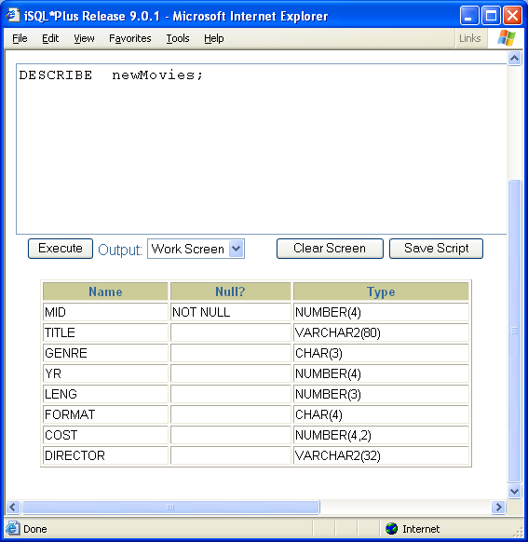
Module 07: DDL Summary Page B-5: ALTER
Consider the table: newMovies.
In the example over the next few pages, I’ll be using this table for my demos.
The plan is to:
Add a new column, named director, with a VARCHAR2(32) datatype;
Remove the column purch_date; and
Change the title column from a 64 character column to an 80 character column.

Slide 8
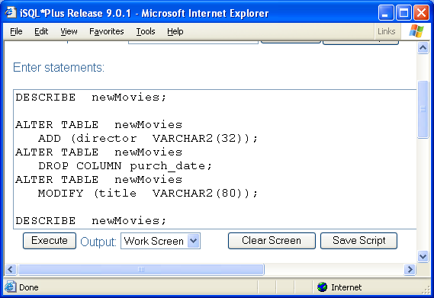
Module 07: DDL Summary Page B-6: ALTER
The plan is to:
Add a new column, named director, with a VARCHAR2(80) datatype;
Remove the column purch_date; and
Change the title column from a 64 character column to an 80 character column.
Here is the code
And the next slide shows the ‘before’ and ‘after’ images of that table.

Slide 9
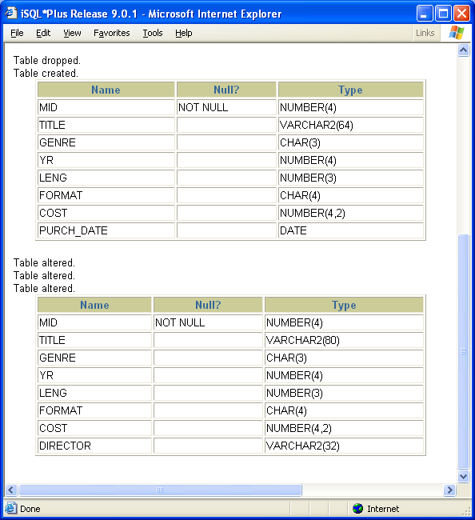
Module 07: DDL Summary Page B-7: ALTER

Slide 10
Module 07: DDL Summary Page B-8: ALTER
Our goal as database administrators, designers, and programmers is to keep the system/database up at all times and available to our user community.
As you can see, the ALTER statement is a great tool for the programmer to keep in her ‘bag of tricks’.
But as good as it is, you should note that the ALTER command does not apply to views.
If you think about it though, this does make sense. A view is a virtual table, it’s a ‘canned’ SQL statement that is executed each time it is called.
It doesn’t make sense then to try to update a piece of a SQL statement, better to replace the whole thing in its entirety.

Slide 11
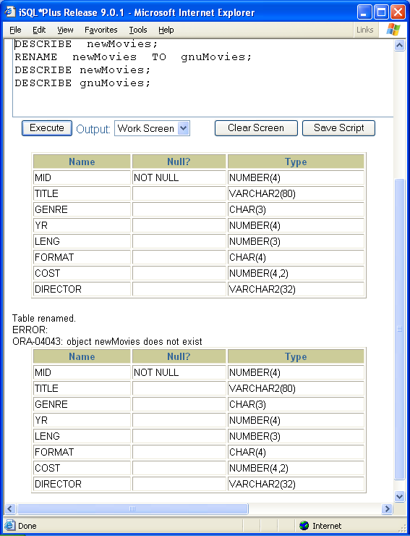
Module 07: DDL Summary Page B-9: RENAME
While we’re on the subject of altering, or changing the characteristics of schema objects, it should be noted that Oracle provides another handy command for the database designer.
RENAME can be used to rename tables.

Slide 12
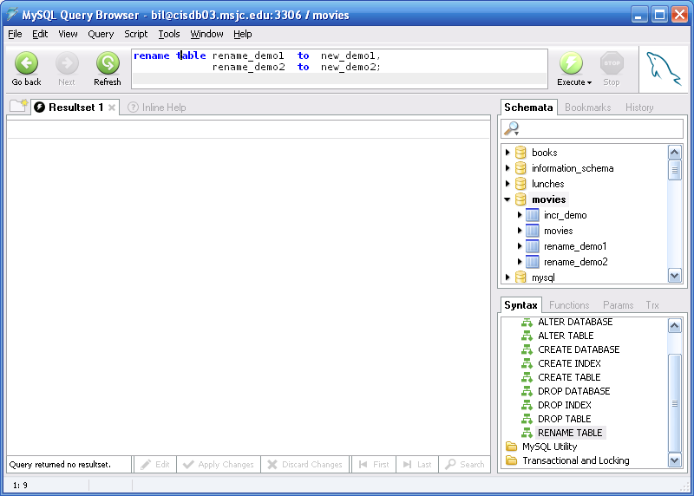
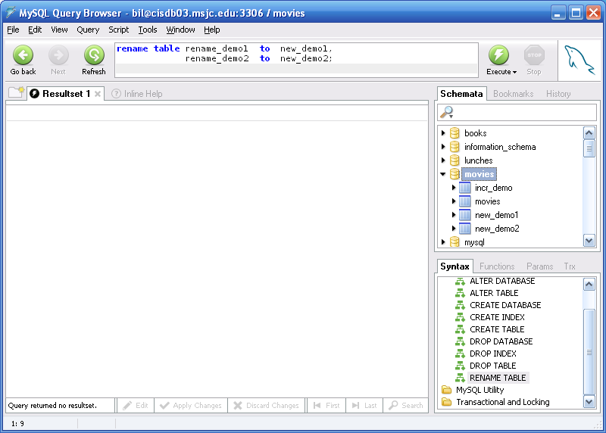
Module 07: DDL Summary Page B-10: RENAME
MySQL also has a RENAME statement for renaming tables.
The syntax is something like this:
RENAME TABLE tbl_name TO new_tbl_name
[, tbl_name2 TO new_tbl_name2] ...
Notice that you can rename multiple tables with a single command.

Slide 13
Module 07: DDL Summary Page C-1: Short Cuts and Miscellany
I need to say a few more words about dropping tables, before we leave this subject.
The general form for removing an object from the database is:
DROP object_type, object_name
But what happens if you drop a table whose rows participate in a foreign key relationship?

Slide 14
Module 07: DDL Summary Page C-2: Short Cuts and Miscellany
I need to say a few more words about dropping tables, before we leave this subject.
The general form for removing an object from the database is:
DROP object_type, object_name
But what happens if you drop a table whose rows participate in a foreign key relationship?
In the section on constraints, we saw that there were various options that could be specified ON DELETE and ON UPDATE conditions. Actions like CASCADE, or SET NULL could be predefined to anticipate the deletion of related records.

Slide 15
Module 07: DDL Summary Page C-3: Short Cuts and Miscellany
The SQL:1999 standard specifies two relevant actions in this regard: RESTRICT and CASCADE.
CASCADE has the effect of ‘cascading’ the effect thru the database, and will first remove any constraints that reference this table, before deleting the table.
The RESTRICT option will restrict any action on the database that violates a referential integrity rule, with the result that if there are rows in the referenced table that relate to rows in the referencing table, the DROP action will not be permitted.

Slide 16
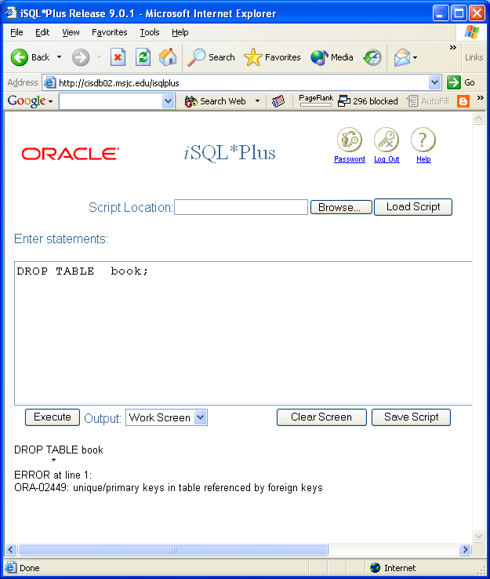
Module 07: DDL Summary Page C-4: Short Cuts and Miscellany
Oracle presumes a ‘restricted’ operation whenever dropping tables (do note that the syntax for Oracle SQL does not allow the programmer to overtly specify RESTRICT).
Since the table book is referenced by rows in other tables, this object cannot be dropped without the CASCADE CONSTRAINTS clause.

Slide 17
Module 07: DDL Summary Page C-5: Truncate
If the programmer is interested in getting a ‘fresh start’ with a table, dropping the table is probably the easiest way to go.
But in a production environment, this might not be the most effective way to proceed.
It could be the case that various permissions have been assigned to the table, so that if the table is to be immediately recreated, those permissions would have to be reinstated.
It could also be the case that some stored code has been written that references the table in question. If the table is deleted, it’s often the case that all stored code that referenced that table would be flagged as ‘invalid’ .
So, more often than not, a fresh start is accommodated by deleting all of the data from the table while preserving the structure of the table.

Slide 18
Module 07: DDL Summary Page C-6: Truncate
And, a command like this:
DELETE
FROM movies;
would do the trick.
But this leads to possible performance issues. ..
You see, Oracle gives programmers and users a ‘second chance’. If you accidentally delete a row from the table, you might be able to undo that action. If you make a change to some of the rows in a table, you might be able to undo that action.
And in order to support this undo feature, Oracle creates before- and after-images of EVERY change to the database.

Slide 19
Module 07: DDL Summary Page C-7: Truncate
Creating all of these before- and after- images is pretty expensive, in terms of database overhead, especially if you’re already sure you want to delete all of the rows.
So, Oracle provides the TRUNCATE command, to mitigate this overhead processing.
Just be warned. A truncated table cannot be recovered by the user.
The syntax for the TRUNCATE command is:
TRUNCATE TABLE table-name
MySQL also provides a TRUNCATE command that behaves in a similar fashion.

Slide 20
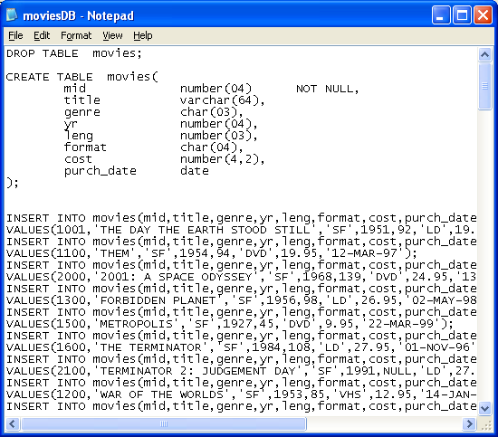
Module 07: DDL Summary Page D-1: Script Files
Long before a database makes it to production, it goes thru a rigorous design phase, which is followed by an initial build phase, which is in turn, followed by testing.
Once all of that is completed, then the full build occurs (all of the production data is loaded into the system), and the system is turned over to operations.
To build that initial database, it’s common for programmers to write a script file that contains all of the DDL statements for the different pieces/sections of the database.
This script file saves us the trouble of typing these commands over and over and over (and over) again as we resolve syntax errors and fine tune our design. The movies database script file is a good example of this kind of script file.

Slide 21
Module 07: DDL Summary Page D-2: Script Files
You’ll see that the first command is the DROP TABLE statement.
This is a preventive measure on my part. If the table already exists, and I were to issue another CREATE TABLE command, SQL would throw an error, and the new CREATE TABLE statement would not be processed.
By issuing a DROP command first, I’m essentially clearing things out, and paving the way for the work that is about to follow.
When I’m working on a new database design, my script file is usually arranged in this fashion:
DROPs – all tables/structure get removed
CREATES – tables are recreated,
constraints are added
stored procedures are ‘stored’
INSERTS – initial data / test data is loaded

Slide 22
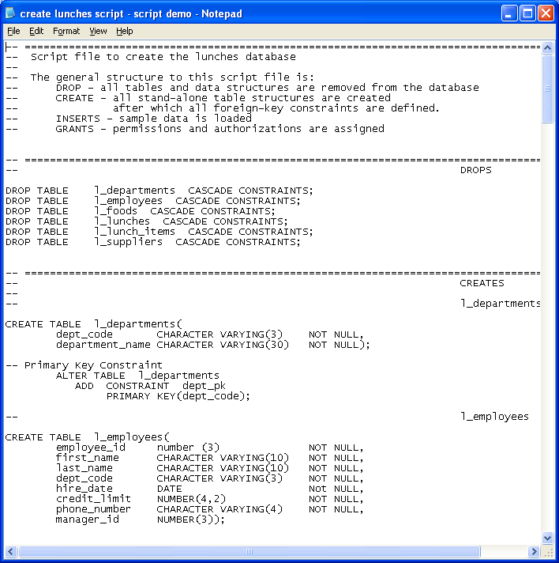
Module 07: DDL Summary Page D-3: Script Files
I’ve provided some supplemental material that provides a pretty good example of a script file for a more ‘substantial’ database (ie. Lunches).
Please check our course site, download the material, and study it.

Slide 23
Module 07: DDL Summary Page E-1: CREATE or REPLACE
Oracle provides a nice extension to the SQL language in regard to building views.
Since views cannot be ALTERed, the only way they can be updated, according to the standard, is with a DROP / CREATE pairing of statements. This could create quite a bit of work for the db designer/programmer, and Oracle provides a useful solution.
When creating a view, the programmer can issue this statement: CREATE or REPLACE VIEW view_name
[further details]
The use of the keyword REPLACE effectively allows the programmer to update a view. This has some benefits, that I’ll discuss in a future module.

Slide 24
Module 07: DDL Summary Page F-1: Schema Objects
CREATE, DROP, and ALTER are used to manipulate the structural elements of a database.
INSERT, DELETE, and UPDATE are used to manipulate the contents of these data-bearing objects.
--
Or to put it another way, CREATE, DROP, and ALTER are used to update the internal structures and features of the database.
INSERT, DELETE, and UPDATE are used to modify the application/business objects in the database.

Slide 25
Module 07: DDL Summary Page F-2: Schema Objects
The structural elements of a database are often referred to as the schema objects, and some of the more ‘common’ schema objects are:
tables
views
domains
character sets
collations
triggers

Slide 26
Module 07: DDL Summary Page F-3: Tables
Tables are the primary data bearing objects in a database.
Tables are named structures that describe columns.

Slide 27
Module 07: DDL Summary Page F-4: Views
A view is a virtual table.
Views do not contain data.
Views are simply a ‘packaged’ SELECT statement that is executed when the named view is referenced.

Slide 28
Module 07: DDL Summary Page F-5: Domains
Domains are essentially a user-defined data type.

Slide 29
Module 07: DDL Summary Page F-6: Character Sets
The database designer is allowed to specify/create a character set for the database to use.

Slide 30
Module 07: DDL Summary Page F-7: Collations
Character sets usually define their own sorting pattern, or collation.

Slide 31
Module 07: DDL Summary Page F-8: Triggers
A trigger is a stored procedure that is executed when a triggering event occurs in the database.
The most common triggering events are those that are associated with the DML commands: INSERT, UPDATE, and DELETE.
For example, a programmer could write a trigger that prevents users from updating a table during off-hours.

Slide 32
Module 07: DDL Summary Page G-1: Data Dictionary
How can we find out what schema objects exist in the database?
Let’s ask the database.
Early on we accepted this statement as our working definition of a database:
A database is a self-describing collection of integrated records (Kroenke, 2003).
One of the key features of this definition is the notion of a database being self-describing. In this regard we say that a database contains the application data, as well as metadata.
Metadata is data, or information, about the data that is maintained in the database.
Thus far the only command that we’ve used to exploit the metadata features of the database has been the DESCRIBE command.

Slide 33
Module 07: DDL Summary Page G-2: Data Dictionary
And now we’re going to look into some Oracle-specific commands that we can use to interrogate the database’s data dictionary.
This data dictionary contains all of the structural information about the data structures in the database.
And the Oracle data dictionary provide three views for us to use in looking at the database structures.

Slide 34
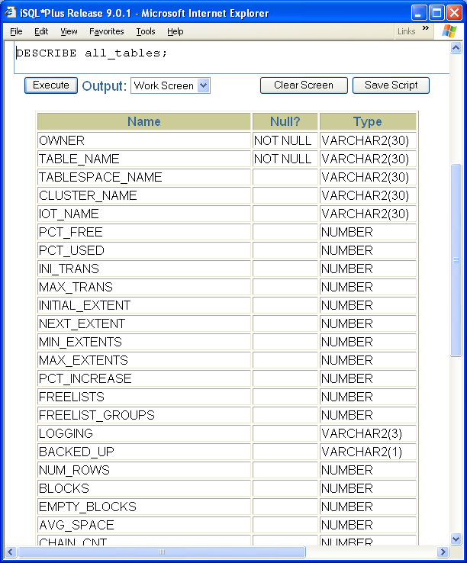
Module 07: DDL Summary Page G-3: Data Dictionary
Each of these categories of views carries one of these three prefixes:
user_view
all_view
dba_view
And the _view part of it, is usually related to the object type you're interested in.
For example, if we were interested in finding out about the structure of a table, we could use the _tables view. That’s half of the equation, now we have to figure out which aspect would best provide the information we need.
User aspect: user_tables
All aspect: all_tables
DBA aspect dba_tables

Slide 35
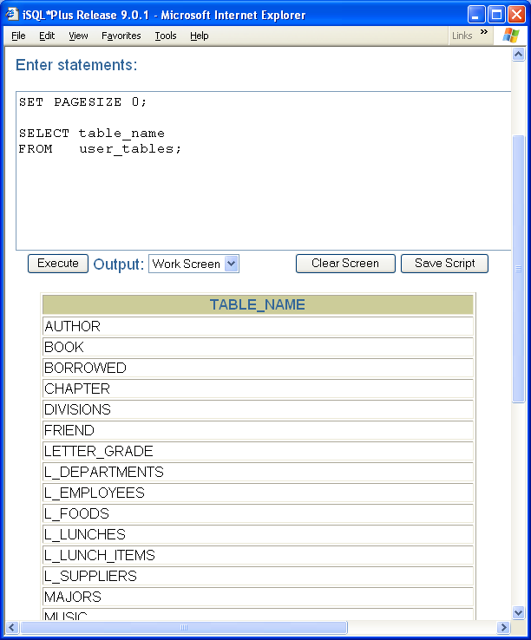
Module 07: DDL Summary Page G-4: User Aspect
The user aspect provides the user with information about tables (objects) that they own.

Slide 36
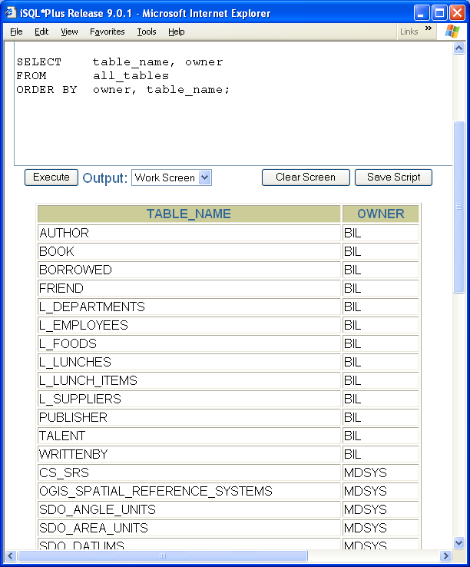
Module 07: DDL Summary Page G-5: All Aspect
The all aspect gives the user information about objects that they own, as well as objects that have been permitted to them.

Slide 37
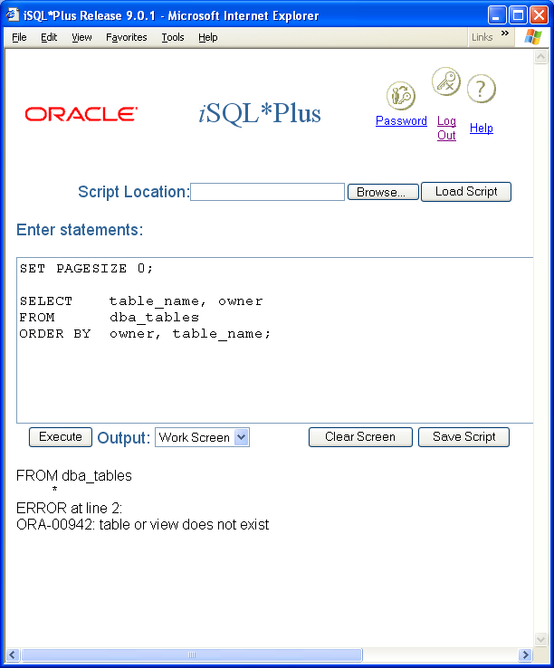
Module 07: DDL Summary Page G-6: DBA Aspect
The dba aspect is available only to a special class of database user, and provides information about any and all structures in the database.
Mere mortals cannot use these dba_views ☺

Slide 38
Module 07: DDL Summary Page H-1: Commonly Used Views
Here are some views that you should be familiar with:
User_tables
User_tab_columns
User_views
User_constraints
User_objects
User_sequences
User_synonyms
User_indexes

Slide 39
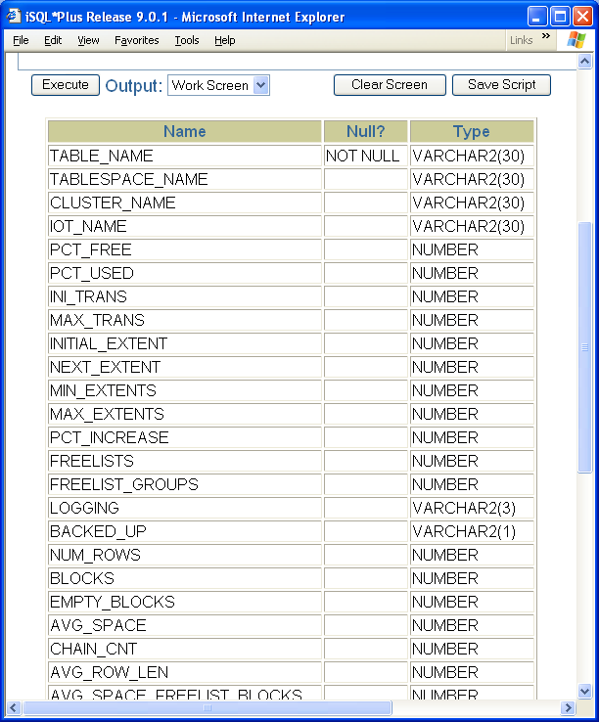
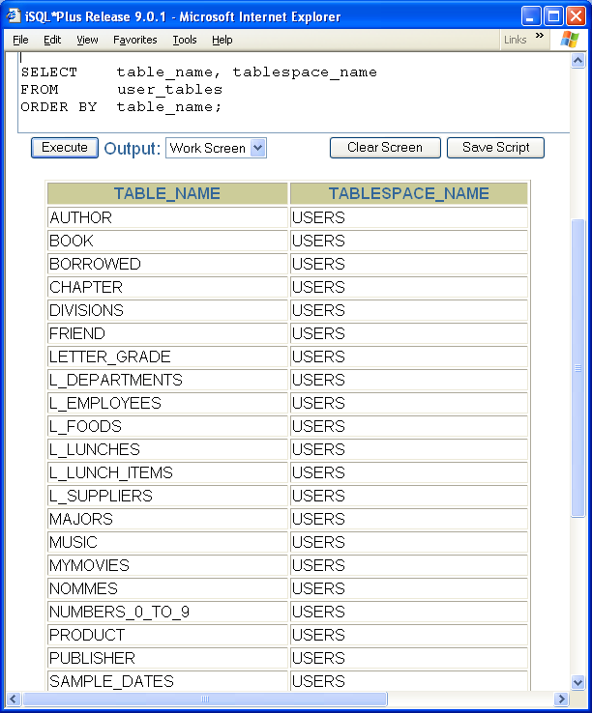
Module 07: DDL Summary Page H-2: user_tables

Slide 40
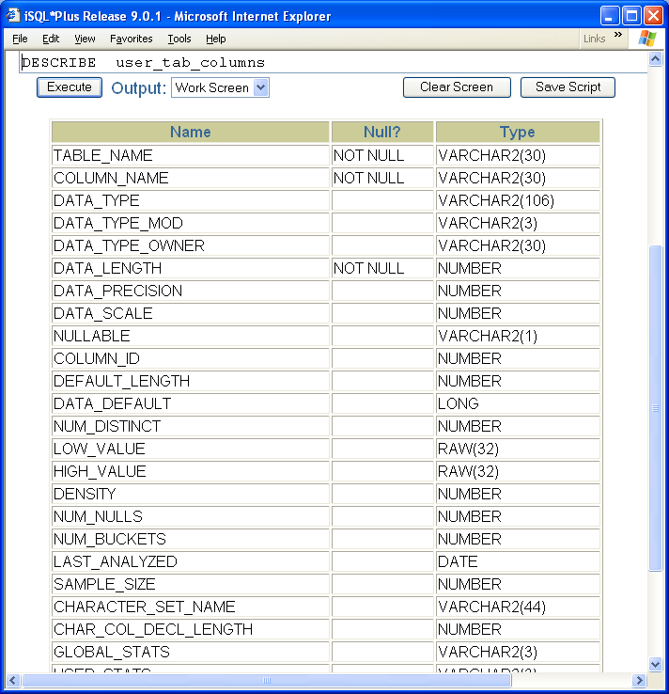
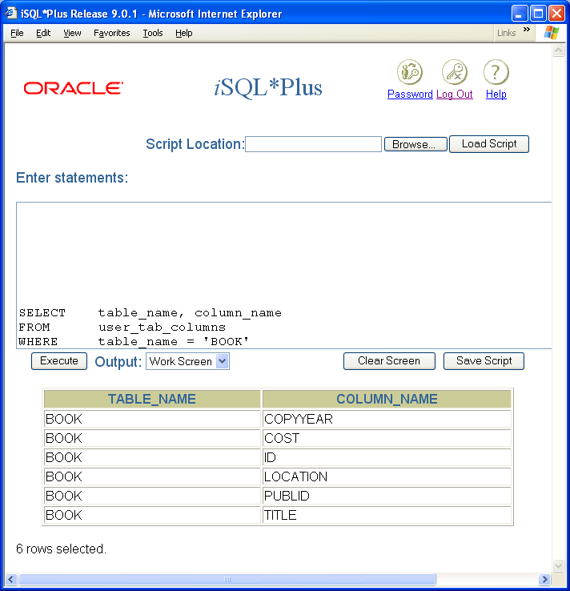
Module 07: DDL Summary Page H-3: user_tab_columns

Slide 41
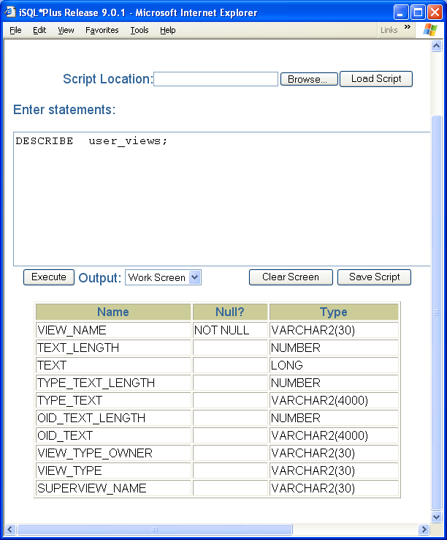
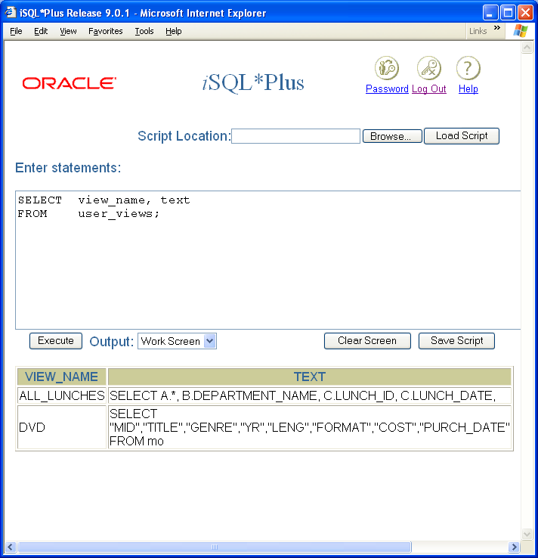
Module 07: DDL Summary Page H-4: user_views

Slide 42
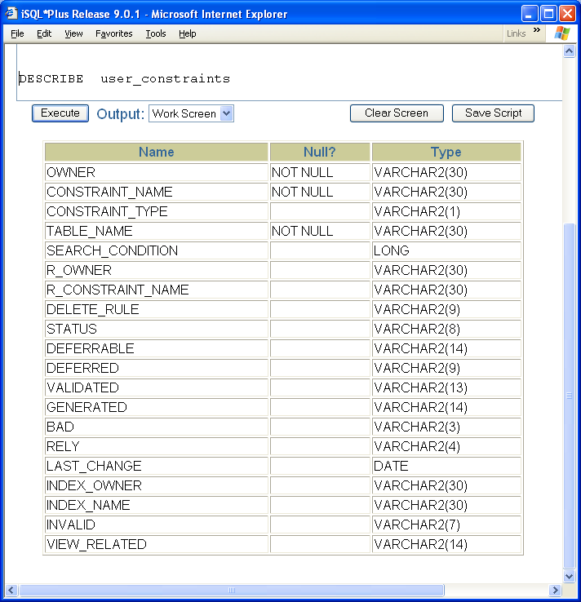
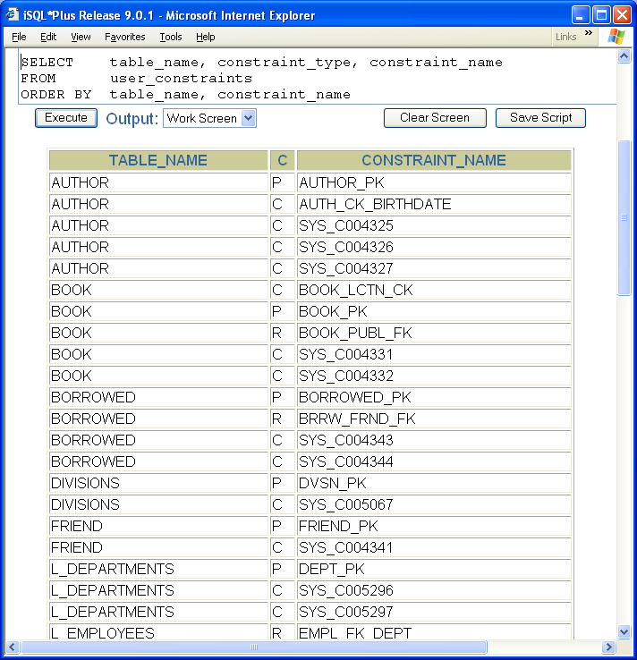
Module 07: DDL Summary Page H-5: user_constraints

Slide 43
Module 07: DDL Summary Page H-6: user_constraints
Those constraints that have the strange looking names, are mostly NOT NULL constraints that were defined at the same time as the table was created.
Since those constraints were not explicitly named, Oracle conjured up its own name to use.
What do you think the values in the “C” column represent?

Slide 44
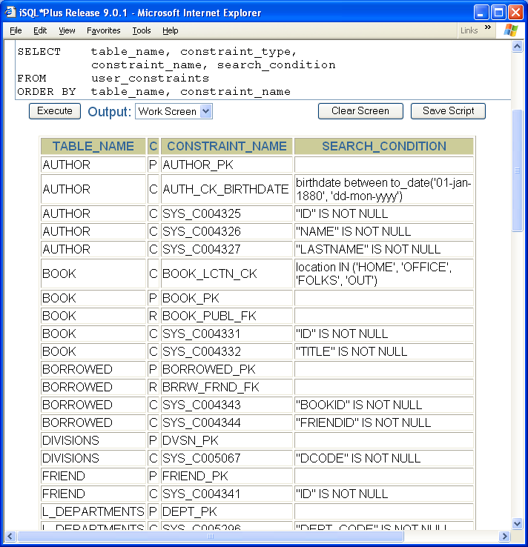
Module 07: DDL Summary Page H-7: user_constraints
This is a handy way to see the ‘contents’ of any constraint.

Slide 45
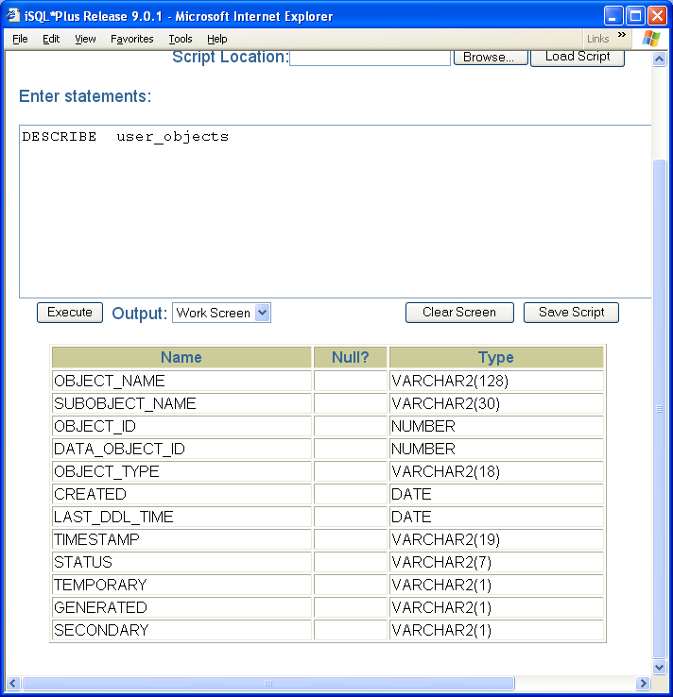
Module 07: DDL Summary Page H-8: user_objects

Slide 46
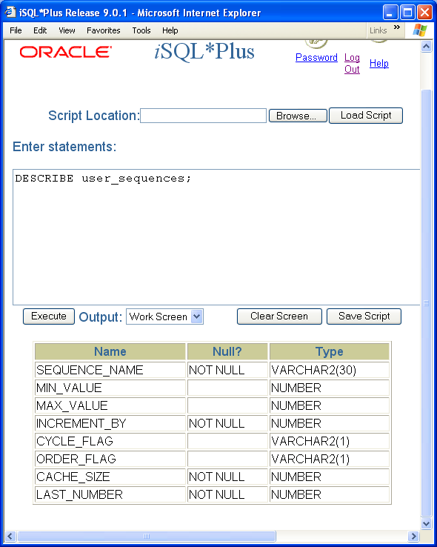
Module 07: DDL Summary Page H-9: user_sequences
These are the columns that are available to the user_sequences view.

Slide 47
Module 07: DDL Summary Page H-9: user_sequences
These are the columns that are available to the user_sequences view.

Slide 48
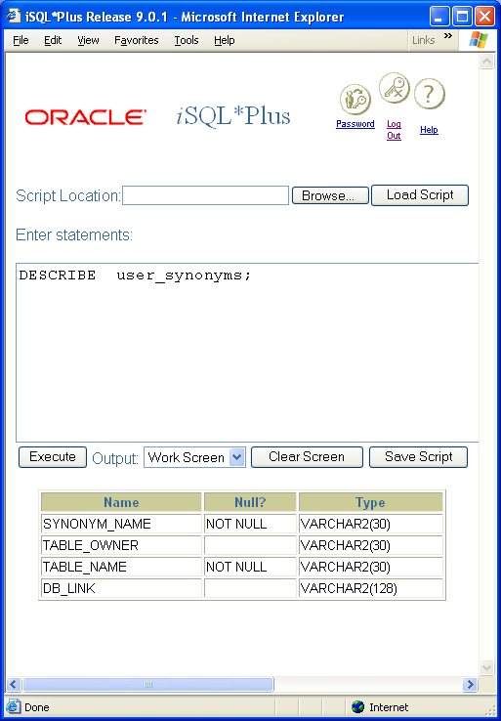
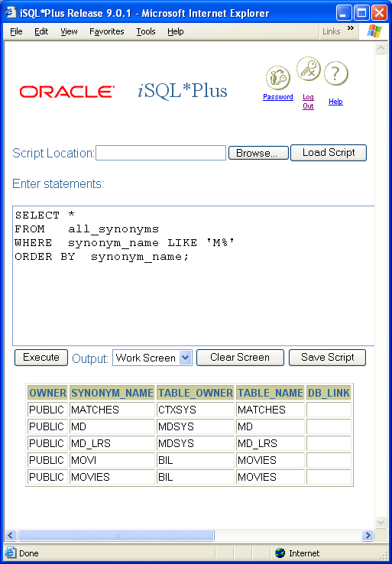
Module 07: DDL Summary Page H-10: user_synonyms
These are the columns that are available to the user_sequences view.

Slide 49
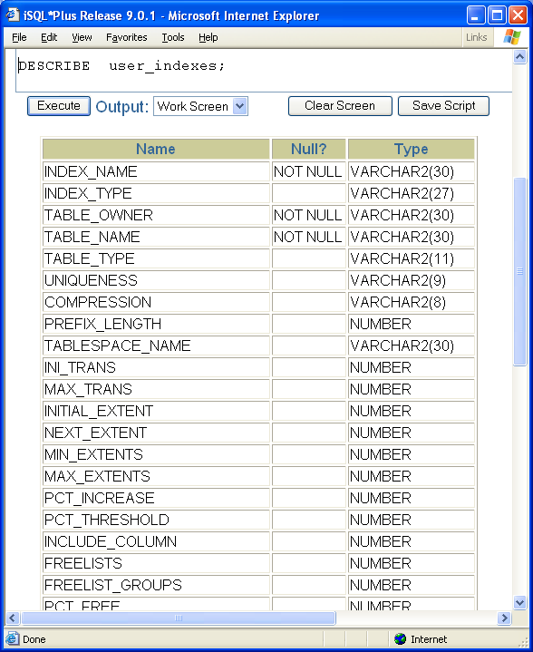
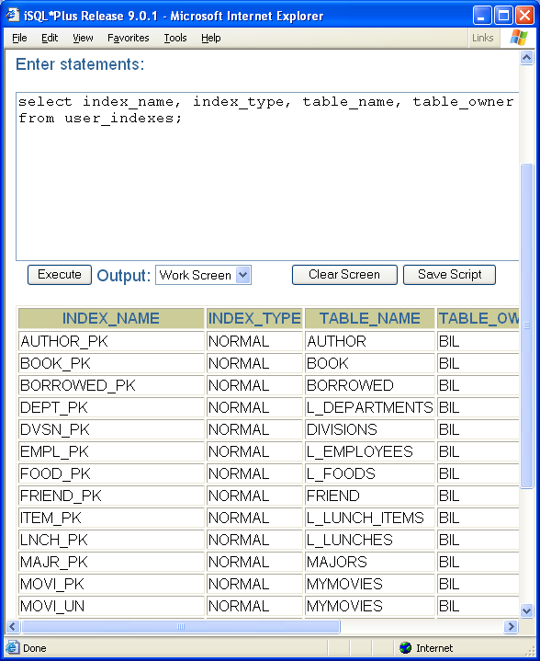
Module 07: DDL Summary Page H-11: user_indexes
Remember that implicitly created indexes are named as the constraint was named.

Slide 50
Module 07: DDL Summary Page H-12: INFORMATION_SCHEMA
MySQL has all of its data dictionary information stored in INFORMATION_SCHEMA.
This approach is more in line with the way the standard recommends the data dictionary be set up and accessed, so we’ll spend a few moments and work thru this implementation.

Slide 51
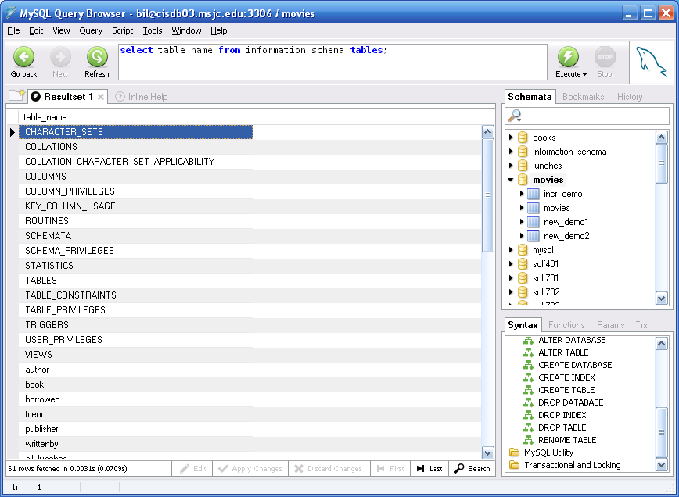
Module 07: DDL Summary Page H-13: INFORMATION_SCHEMA
So, what does the INFORMATION_SCHEMA keep track of?
Let’s ask it:

Slide 52
Module 07: DDL Summary Page H-14: INFORMATION_SCHEMA
On the face of it, it appears that the INFORMATION_SCHEMA keeps track of information about each of the:
Character sets
Collations
Columns
Column privileges
Tables
Table constraints
Table privileges
User privileges
Views
As well as information about each of the objects themselves:
For example:
author
book
publisher

Slide 53
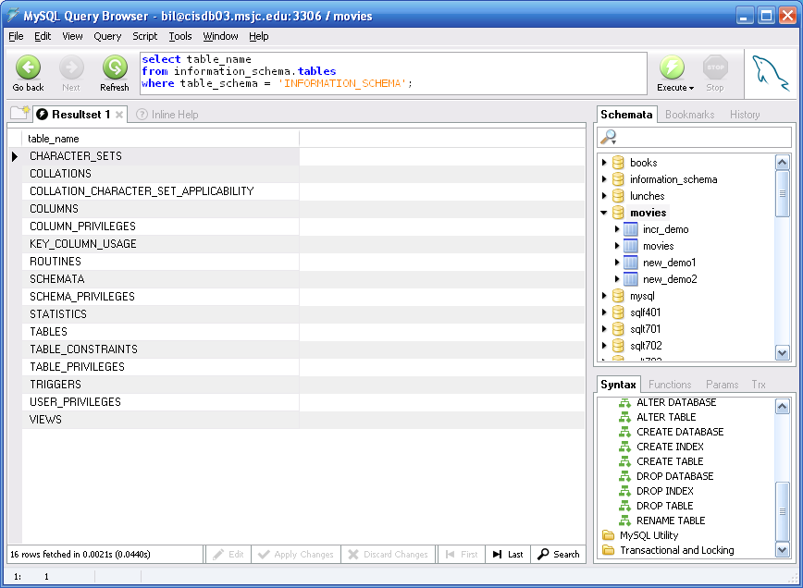
Module 07: DDL Summary Page H-14: INFORMATION_SCHEMA
Let’s just focus on the meta information for now.
I’ll rewrite my query accordingly – I just want the ‘big picture’ ☺
(you should notice the WHERE clause)

Slide 54
Module 07: DDL Summary Page H-15: INFORMATION_SCHEMA
As you examine the SCHEMATA window in the accompanying diagram you should notice that my listing of schemata includes more entries than you’re used to seeing.
That’s because my user account is one of the authorized database administrator accounts on the system, and I get to see ‘everything’ that this MySQL instance is associated with.

Slide 55
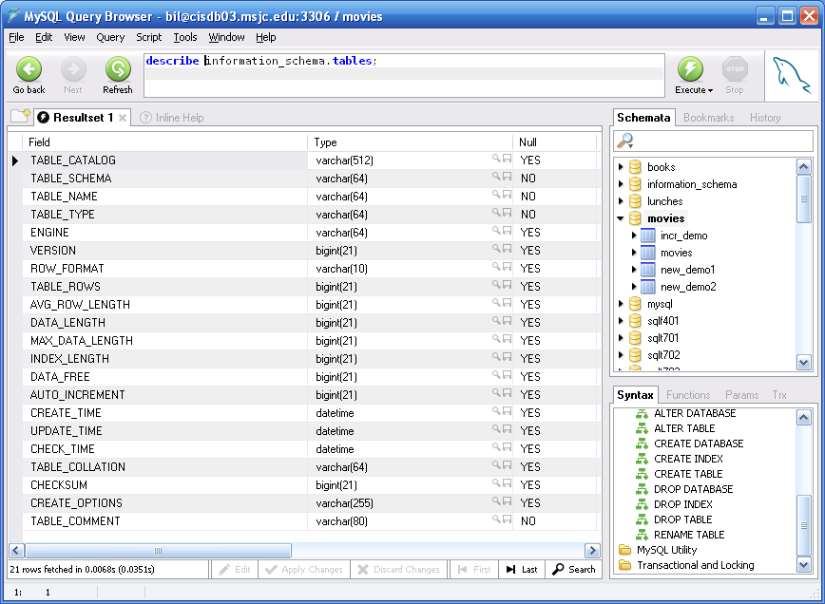
Module 07: DDL Summary Page H-16: INFORMATION_SCHEMA
Here is a description of the information_schema table:

Slide 56
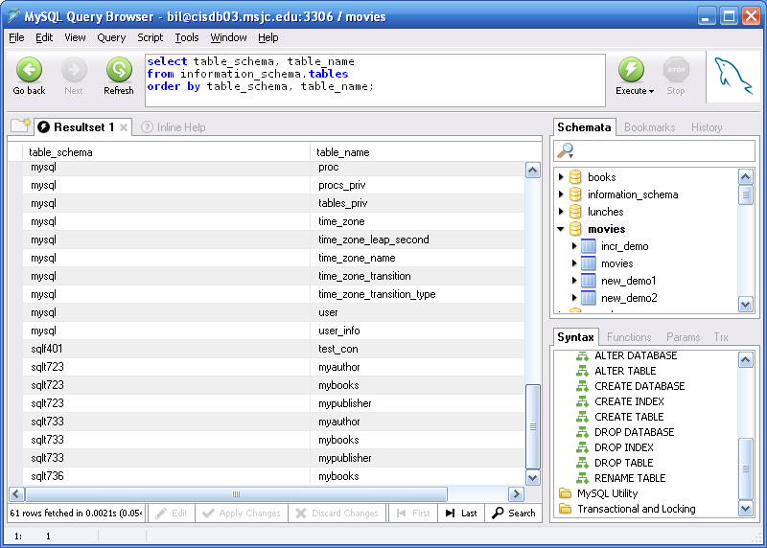
Module 07: DDL Summary Page H-17: INFORMATION_SCHEMA
If I want to know about ALL of the tables on this system I could issue this command:

Slide 57
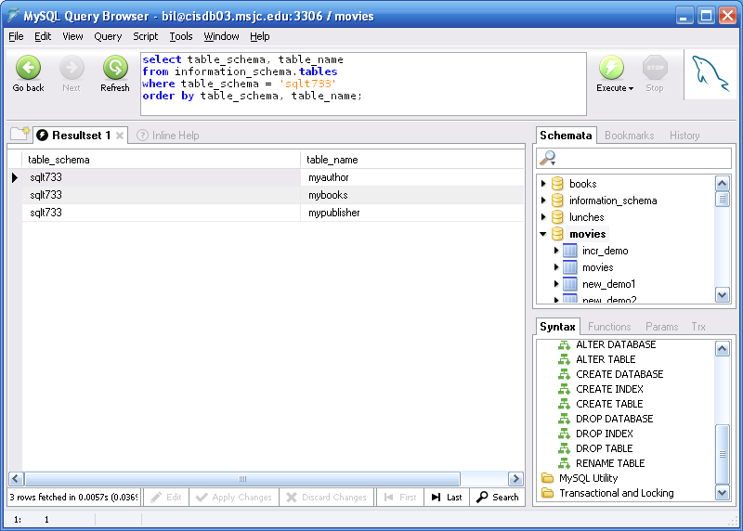
Module 07: DDL Summary Page H-18: INFORMATION_SCHEMA
If I want to know about just a single schemata I could issue a command like this.
Note: schemata are ‘analogous’ to users in the Oracle database system. If you think of them that way, that’ll be good enough for your ‘intuitions’ at this level.

Slide 58
Module 07: DDL Summary Page H-19: Challenge
Given what you’ve seen of the INFORMATION_SCHEMA, can you figure out how to get information about the tables in your ‘account’?
How about the constraints you’ve created?
How about the views?

Slide 59
Module 07: DDL Summary Page T-1: Terminology
CREATE, CREATE OR REPLACE
DROP
ALTER
TRUNCATE
cascade, restrict
Schema object
Table
Views
Domains
Character sets
Collations
Triggers
INFORMATION_SCHEMA
User_views
All_views
Dba_views
_tables, _views, _constraints,
_objects, _sequences, _indexes

Slide 60
Module 07: DDL Summary Page Z-1: End Notes
Please drop me an email if you noticed any errors in this module. I’d also appreciate reading your comments, criticisms, and or suggestions as to how this module could be improved.
Were there any gaps in the information that was presented (ie. ‘leaps of faith’)?
Was any section unclear?
Did I happen to do a good job? ☺
Thanks,
bil

Slide 61
That’s All

